Slide 1

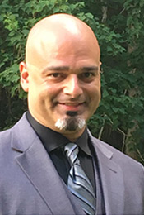
Cultural Competence in Counseling Psychology
Presented By:
Dr. Pete Cooper Ph.D., LPC-S

Slide 2
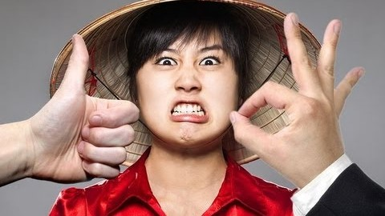
10 Surprising Ways To Offend People In Other Countries

Slide 3
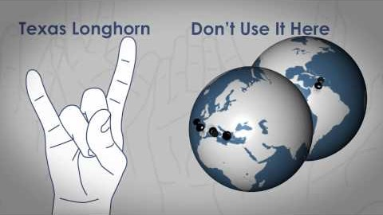
American Hand Gestures in Different Cultures - 7 Ways to Get Yourself in Trouble Abroad

Slide 4
“All people share a common human nature. Our shared human nature is intensely social: we are group animals. We use language and empathy, and practice collaboration and intergroup competition. But the unwritten rules of how we do these things differ from one human group to another. "Culture" is how we call these unwritten rules about how to be a good member of the group. Culture provides moral standards about how to be an upstanding group member; it defines the group as a "moral circle". It inspires symbols, heroes, rituals, laws, religions, taboos, and all kinds of practices - but its core is hidden in unconscious values that change at a far slower rate than the practices. We tend to classify groups other than our own as inferior or (rarely) superior. This applies to groups based on national, religious, or ethnic boundaries, but also on occupation or academic discipline, on club membership, adored idol, or dress style. In our globalized world most of us can belong to many groups at the same time. But to get things done, we still need to cooperate with members of other groups carrying other cultures. Skills in cooperation across cultures are vital for our common survival.” - Gert Jan Hofstede

Slide 5
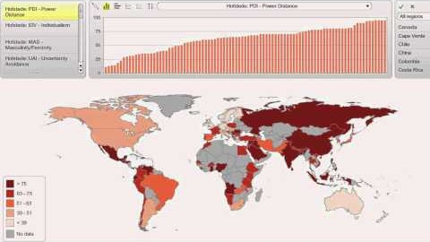
Map The World - Hofstede's 5 Cultural Dimensions Visualized on a World Map

Slide 6
Scenario I
A 52 year old Japanese man named Sho and his girlfriend Becky come to you for counseling at the behest of his girlfriend of 2 years. The Japanese man’s girlfriend Becky is 40 years old. Sho was born and raised in the Iga province of Japan until he was 9 years old and then moved to Osaka and spent the remaining 41 years of his life traveling throughout Japan and Southeast Asia as a marketing executive. At this point, Sho’s wife Yukie died from a 7 year long battle with cancer and Sho moved to Los Angeles. After about 4 months of living and working in Los Angeles, Sho met Becky while he was walking in Venice Beach, the two developed a friendship which quickly blossomed into an intimate relationship. However, Becky (a native of Los Angeles) has been stating over the past year that Sho is sexist, domineering and does not respect women. Becky states that the intimate aspects of their relationship are still excellent, but has great difficulty in moving forward with Sho’s general attitude towards women. Becky states that her emotional needs are not being met and that Sho has the attitude that women should primarily be mothers and caregivers and that they should be primarily responsible for taking care of a husband’s needs and tending to the needs of children. Sho states that he is also tiring of the relationship since he feels that his emotional needs are also not being met by Becky.

Slide 7
Scenario II
Melina is a 30 year old Black woman who has been in an intimate relationship with a 35 year old White man named Jason for almost a year. Both were born and raised in Brooklyn, NY albeit in different neighborhoods. Jason was born and raised in the Bensonhurst section of Brooklyn and Melina was born and raised in the Bedford-Stuyvesant and Brownsville sections of Brooklyn. Jason is an automobile mechanic and Melina is a legal secretary. They both come to you for counseling because they love each other very much and feel very strongly in every way for each other, however, both of their families strongly disapprove of the relationship. Each of their families have very opposing views of an interracial relationship and both families have used racial epithets against the other partner when Melina and Jason brought each other home to meet their respective families.

Slide 8
Scenario IV
Steve is a 72 year old native of Bangor, ME and has just moved to Houma, LA. Steve had been drafted into the U.S. Army when he was 22 and sent to Vietnam in 1965. Steve had seen ground combat in Pleiku and Chu Lai as well as Kon Tum. After being honorably discharged in 1967 due to losing his leg in combat, Steve moved back home to ME, and was unable to secure work. He continued living with his parents at this time and turned to drug and alcohol abuse as a result of suffering from post-traumatic stress disorder, major clinical depression and being confined to a wheelchair. The friends he once had before being drafted no longer spoke to him and stated that he got what he deserved for going to fight in that war and would call him things such as “baby killer” and would spit on him whenever they saw him around town. Eventually by 1971, due to Steve being unable to secure work, his increased drug and alcohol consumption, being confined to a wheelchair, having no friends left in town and his parents being killed in an automobile accident, he decides to hitchhike to Arizona where he finds himself on a Hopi Indian reservation when one of the drivers is (a Hopi Indian) who picks him up has a brother who also served in Vietnam. The Hopi take care of him in exchange for his helping out on the reservation and Steve stays there.

Slide 9
Over the years, Steve continued to stay with the Hopi but by the 1980’s Steve admitted himself into the VA hospital where he was able to become sober and was also furnished with a titanium prosthetic leg. He also secured a job at the hospital assisting other veterans. Over the years, he was reassigned (at his request) when his granddaughter was offered a scholarship to attend LSU in 2013. He comes to you for counseling because he still suffers from depression, has recently had flashbacks from the war which not occurred in a longtime and has had a relapse of alcohol consumption. He is having difficulty in adjusting to his new environment.

